Slide 1

Statistics
Basics of Statistics
Introduction to Statistics
Different areas of statistics
Measure of Central tendency

Slide 2

LinkedIn :- Mayank Aggarwal | LinkedIn

Slide 3
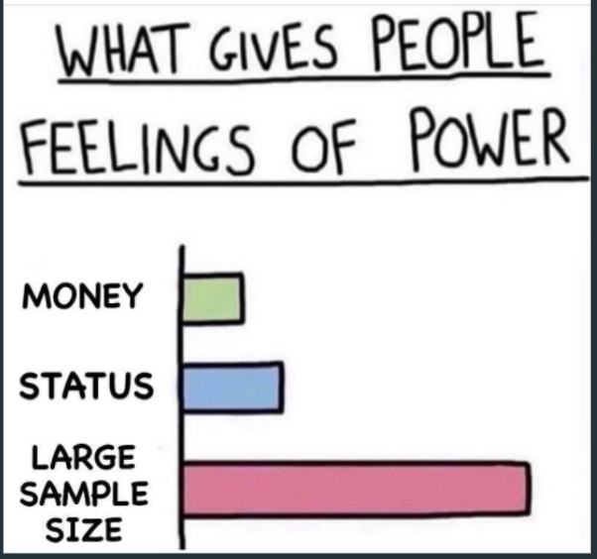
Statistics

Slide 4
What does Data Scientist Do ?

Slide 5
What is Statistics
Statistics is the science of conducting studies to collect, organize, summarize, analyze and draw conclusion out of the data.
Statistics deals with collective informative data, interpreting these data and drawing conclusion from data.
Statistics are used in many disciplines: Healthcare, Business, Education, Insurance, Marketing, telecom etc.

Slide 6
Two areas of statistics
Descriptive Statsitics

Slide 7
Inferential Statistics

Slide 8
Jargons of Statistics
Population
Sample
Variable
Data (singular)
Data (plural)
Experiment
Parameter
Statistic

Slide 9
Central Tendency
What is a measure of central tendency?
A measure of central tendency is a descriptive statistic that describes the average, or typical value of a set of scores
Three Common Measures of Central Tendency
Mode
Median
Mean

Slide 10
Mode
The mode is the score that occurs most frequently in a set of data
The mode is primarily used with nominally scaled data
It is the only measure of central tendency that is appropriate for nominally scaled data

Slide 11
Mean
The mean is:
the arithmetic average of all the scores (ΣX)/N
The mean of a population is represented by the Greek letter μ; the mean of a sample is represented by X

Slide 12
Median
The median is simply another name for the 50th percentile
It is the score in the middle; half of the scores are larger than the median and half of the scores are smaller than the median

Slide 13
Range

Slide 14
Question
Find the mean, median, mode, and range for the given data
190, 153, 168, 179, 194, 153, 165, 187, 190, 170, 165, 189, 185, 153, 147, 161, 127, 180

Slide 15
Categorical vs Numerical Variable

Slide 16
FIN.
Ask your doubts in comments Section
Notes:
Ask your doubts in comments Section

